Slide 1


INTEGRASI ADMIN LTE DENGAN CODEIGNITER
JIHADUL AKBAR
Pertemuan II

Slide 2
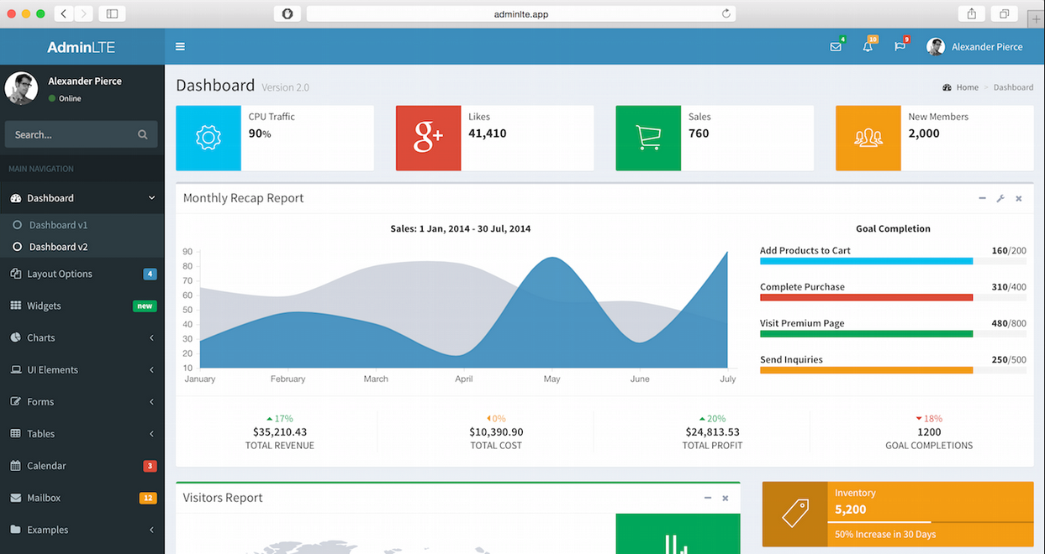

Slide 3


Slide 4
ADMIN LTE
Is a fully responsive admin template. Based on Bootstrap 3 framework. Highly customizable and easy to use. Fits many screen resolutions from small mobile devices to large desktops. Check out the live preview now and see for yourself.

Slide 5
Source
https://adminlte.io/
Official Website
https://github.com/almasaeed2010/AdminLTE/releases
Rekease New Admin LTE
https://github.com/almasaeed2010/AdminLTE
Github Admin LTE

Slide 6
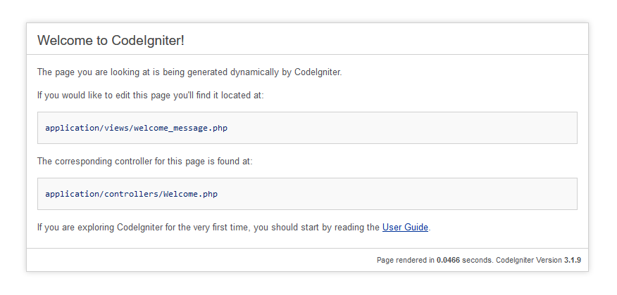
Step 1
Success Install Codeniter in local computer

Slide 7
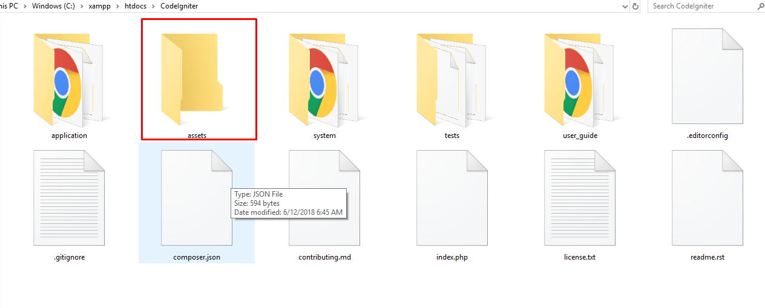
Step 2
Create asset folder on base directory CodeIgniter

Slide 8

Step 3
In asset folder create folder css, js and image for save all library admin lte

Slide 9
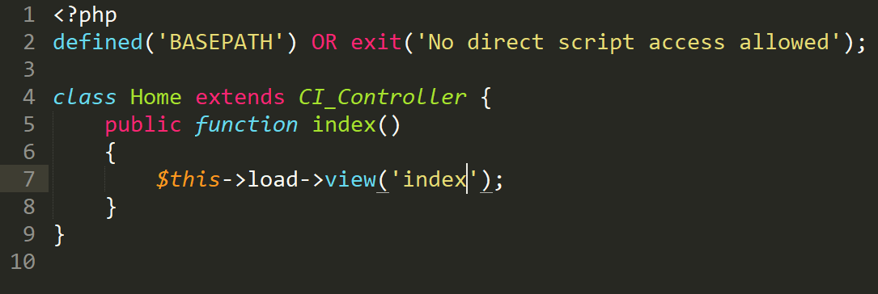
Step 4
Create controller home in ./application/controllers/Home.php

Slide 10
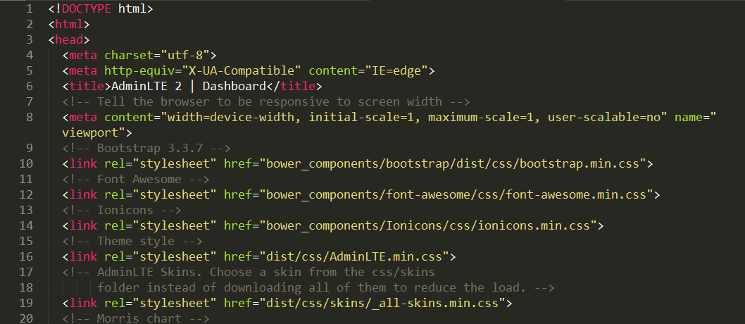
Step 5
Create view index in ./application/views/index.php and
copy all code from index.htm on Admin LTE

Slide 11
Step 6
Load Cascading Style Sheet (CSS)
Load Javascrept
On link css and js edit for load core css and js

Slide 12
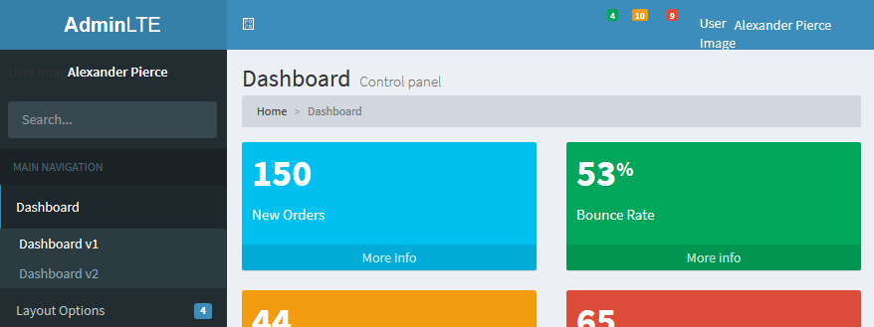
Step 7
Access home page with this url : localhost/codeingiter/index.php/Home

Slide 13
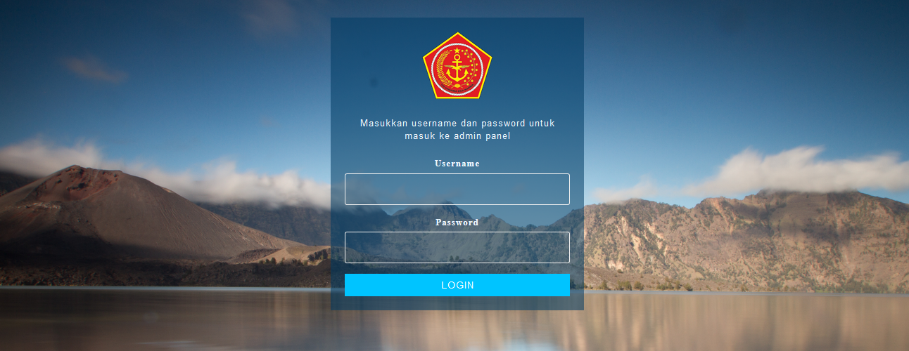
Step 8
Edit and modification your dashboard like you wont

Slide 14

Thank You ☺
Next Create Read Update and Delete
Image form www.pexels.com

